Slide 1
Analog Transmission

Slide 2














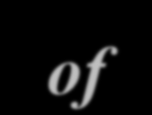







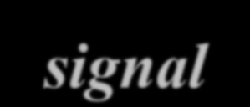





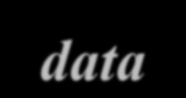


5-1 DIGITAL-TO-ANALOG CONVERSION
Digital-to-analog conversion is the process of changing one of the characteristics of an analog signal based on the information in digital data.
Topics discussed in this section:
Aspects of Digital-to-Analog Conversion
Amplitude Shift Keying
Frequency Shift Keying
Phase Shift Keying
Quadrature Amplitude Modulation

Slide 3
Digital to Analog Conversion
Digital data needs to be carried on an analog signal.
A carrier signal (frequency f_{c}) performs the function of transporting the digital data in an analog waveform.
The analog carrier signal is manipulated to uniquely identify the digital data being carried.

Slide 4
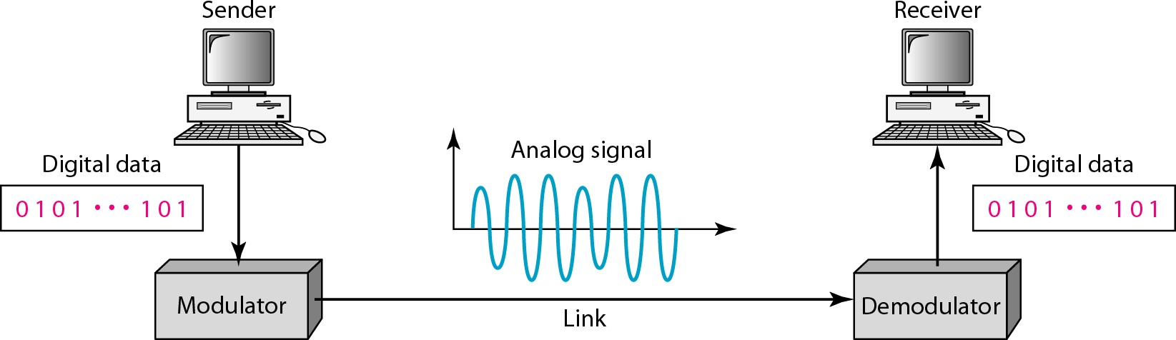
Figure 5.1 Digital-to-analog conversion

Slide 5
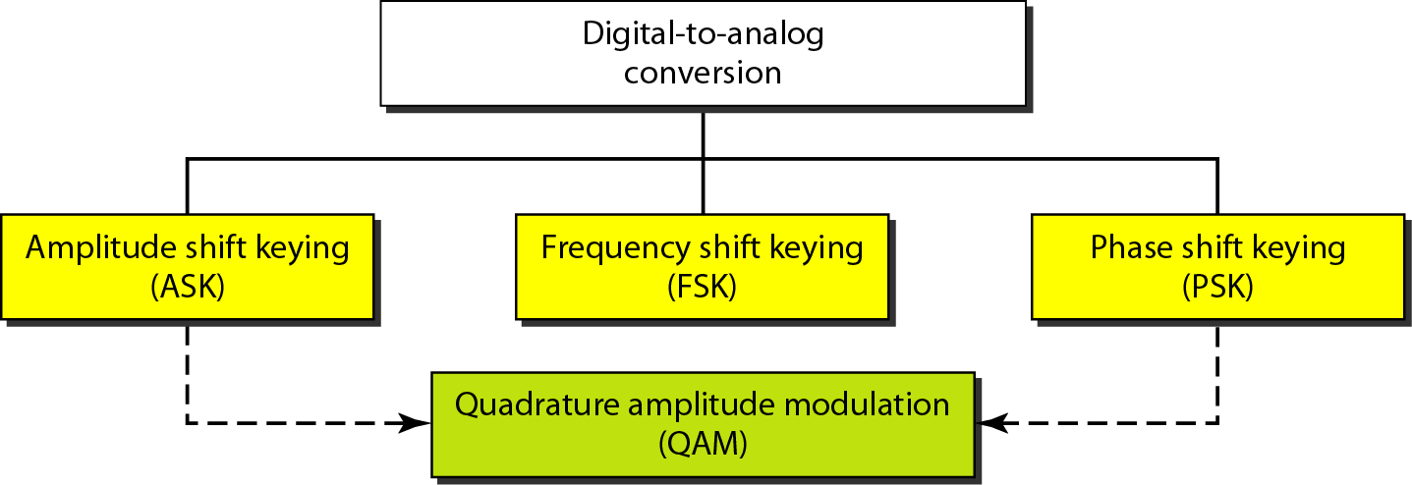
Figure 5.2 Types of digital-to-analog conversion

Slide 6




Bit rate, N, is the number of bits per second (bps). Baud rate is the number of signal
elements per second (bauds).
Note
In the analog transmission of digital data, the signal or baud rate is less than or equal to the bit rate.
S=Nx1/r bauds
Where r is the number of data bits per signal element.

Slide 7
Example 5.1
An analog signal carries 4 bits per signal element. If 1000 signal elements are sent per second, find the bit rate.
Solution
In this case, r = 4, S = 1000, and N is unknown. We can find the value of N from

Slide 8
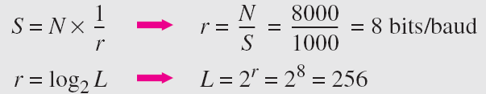
Example 5.2
An analog signal has a bit rate of 8000 bps and a baud rate of 1000 baud. How many data elements are carried by each signal element? How many signal elements do we need?
Solution
In | this |  | example, |  | S | = | 1000, |  | N = |  | 8000, | and | r | and
L are |  | unknown. |  | We | find |  |  | first |  | the | value | of | r | and
then |  | the value |  | of | L.

Slide 9
Amplitude Shift Keying (ASK)
ASK is implemented by changing the amplitude of a carrier signal to reflect amplitude levels in the digital signal.
For example: a digital “1” could not affect the signal, whereas a digital “0” would, by making it zero.
The line encoding will determine the values of the analog waveform to reflect the digital data being carried.

Slide 10
Bandwidth of ASK
The bandwidth B of ASK is proportional to the signal rate S.
B = (1+d)S
“d” is due to modulation and filtering, lies between 0 and 1.

Slide 11
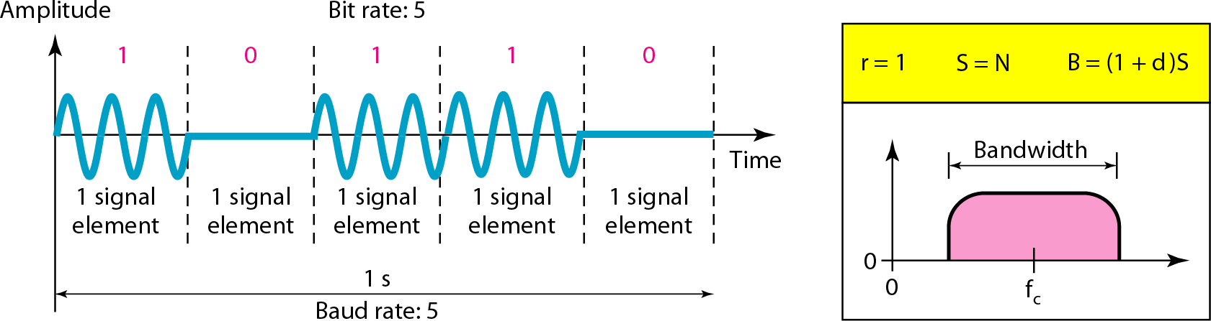
Figure 5.3 Binary amplitude shift keying

Slide 12
Frequency Shift Keying
The digital data stream changes the frequency of the carrier signal, f_{c}.
For example, a “1” could be represented by f₁=f_{c} +Δf, and a “0” could be represented by f₂=f_{c}-Δf.

Slide 13
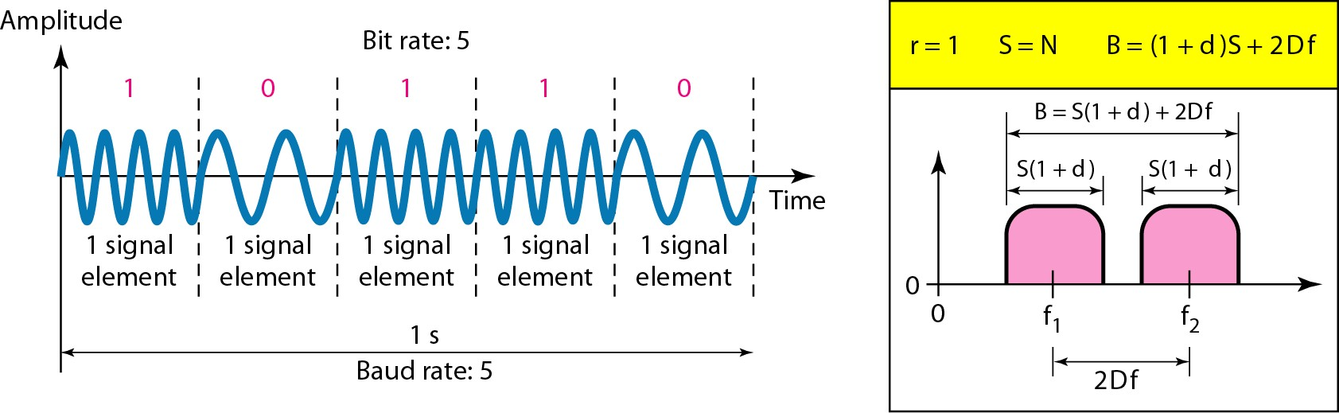
Figure 5.6 Binary frequency shift keying

Slide 14
Bandwidth of FSK
If the difference between the two frequencies (f₁ and f₂) is 2Δf, then the required BW B will be:
B = (1+d)xS +2Δf

Slide 15
Example 5.5
We have an available bandwidth of 100 kHz which spans from 200 to 300 kHz. What should be the carrier frequency and the bit rate if we modulated our data by using FSK with d = 1?
Solution
This problem is similar to Example 5.3, but we are modulating by using FSK. The midpoint of the band is at 250 kHz. We choose 2Δf to be 50 kHz; this means

Slide 16
Phase Shift Keyeing
We vary the phase shift of the carrier signal to represent digital data.
The bandwidth requirement, B is: B = (1+d)xS
PSK is much more robust than ASK as it is not that vulnerable to noise, which changes amplitude of the signal.

Slide 17
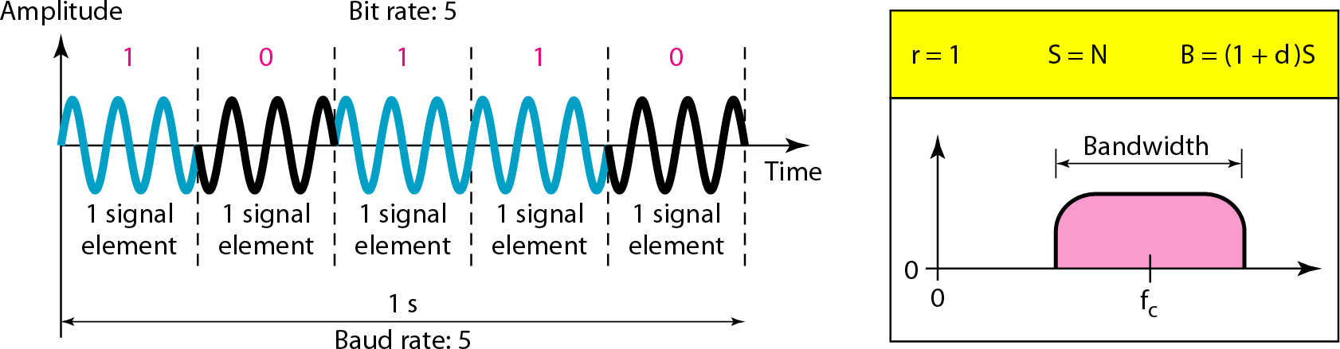
Figure 5.9 Binary phase shift keying

Slide 18
Quadrature PSK
To increase the bit rate, we can code 2 or more bits onto one signal element.
In QPSK, we parallelize the bit stream so that every two incoming bits are split up and PSK a carrier frequency. One carrier frequency is phase shifted 90º from the other - in quadrature.
The two PSKed signals are then added to produce one of 4 signal elements. L = 4 here.

Slide 19
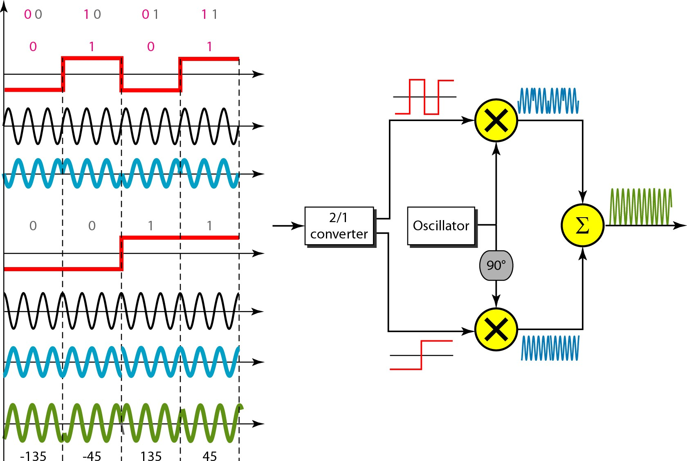
Figure 5.11 QPSK and its implementation

Slide 20
Note
Quadrature amplitude modulation is a combination of ASK and PSK.

